Slide 1
PRE-EVENT POWERPOINT TEMPLATE
NOTES & INSTRUCTIONS
Use of Slides
Feel free to edit content and delete or duplicate slides as you need. We recommend at least including the first three slides and the final slide.
Slide Timing & Looping
By default, each slide is timed to advance after 10 seconds on a continuous loop.
To update slide transitions and timing for each slide, navigate to the Transitions tab.
Creating QR Codes for Giving Links
Request a new QR code : UA Supportal (UA log in credentials required)
Email casadser@uw.edu for assistance with creating a QR Code.
Sourcing Photos & Graphics
Explore graphics and photos on the UMAC's website.
When ready, don't forget to delete this slide before presenting.

Slide 2
WELCOME TO
THE HUSKY LECTURE
Subtitle text here

Slide 3
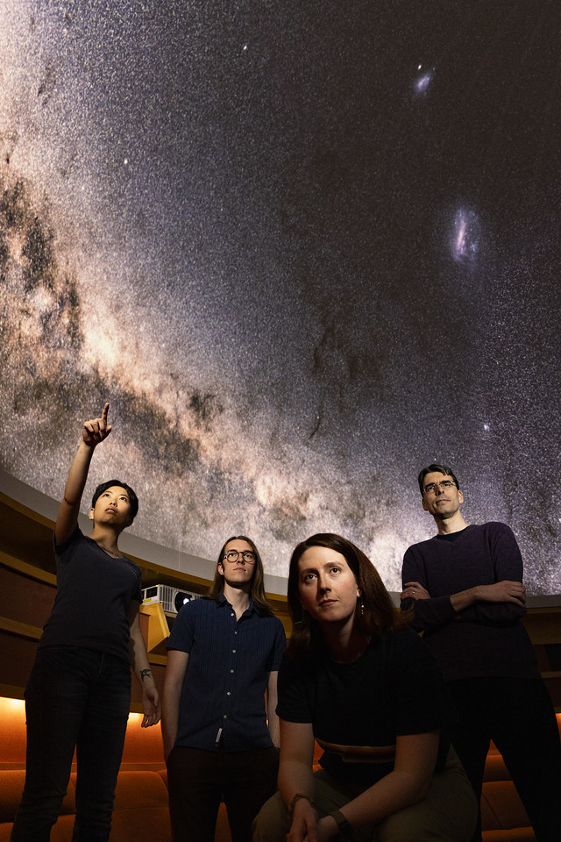
AGENDA
5:30 pm Lecture
6:30 pm Q&A Session
7:00 pm Reception & Book Signing

Slide 4
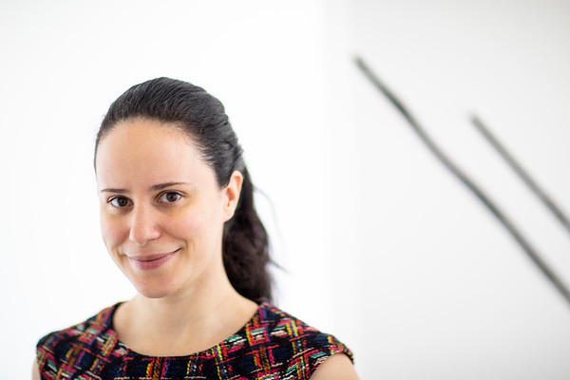
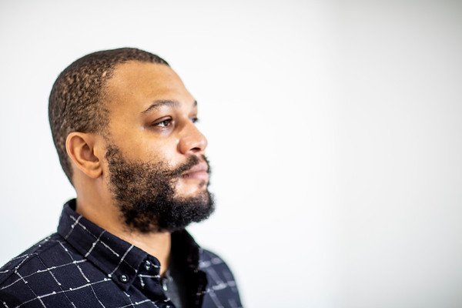
ABOUT OUR SPEAKERS
Dr. Dubs Husky, Lead Scientist
Ci quodi verum quam net velesed ut et ernatur aditium arum experum imus, simi, sit la doluptatenis volorio. Iquuntia nossequae que moditissi accum veligen dandem soluptatius maxime sam.
Dr. Dubs Husky, Lead Scientist
Ci quodi verum quam net velesed ut et ernatur aditium arum experum imus, simi, sit la doluptatenis volorio. Iquuntia nossequae que moditissi accum veligen dandem soluptatius maxime sam.

Slide 5
DID YOU KNOW?
The Department of Chemistry has over 50 students graduate with a _________!

Slide 6
DID YOU KNOW?
Bruce Lee studied Drama at the University of Washington!

Slide 7
SUPPORT US
Now more than ever, your support helps to sustain important teaching and research. Thank you for your support.
Insert QR Code Here
artsci.uw.edu/give

Slide 8

UPCOMING EVENTS
AN EVENING WITH PROFESSOR
February 22, 2028 | 5:30 pm – 7:00 pm
Insert QR Code Here
Ci quodi verum quam net velesed ut et ernatur aditium arum experum imus, simi, sit la doluptatenis volorio.
AN EVENING WITH PROFESSOR
February 23, 2028 | 5:30 pm – 7:00 pm
Insert QR Code Here
Ci quodi verum quam net velesed ut et ernatur aditium arum experum imus, simi, sit la doluptatenis volorio.

Slide 9
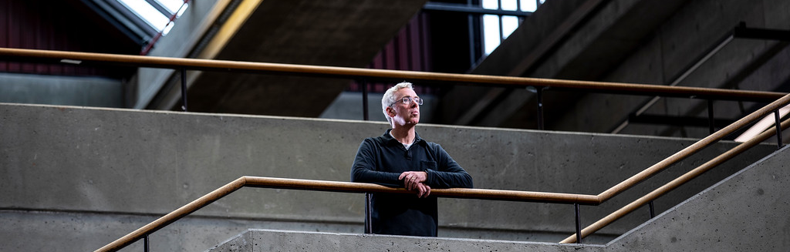
UPCOMING EVENTS
Insert QR Code Here
AN EVENING WITH PROFESSOR
February 22, 2028 | 5:30 pm – 7:00 pm
Ci quodi verum quam net velesed ut et ernatur aditium arum experum imus, simi, sit la doluptatenis volorio. Iquuntia nossequae que moditissi.

Slide 10
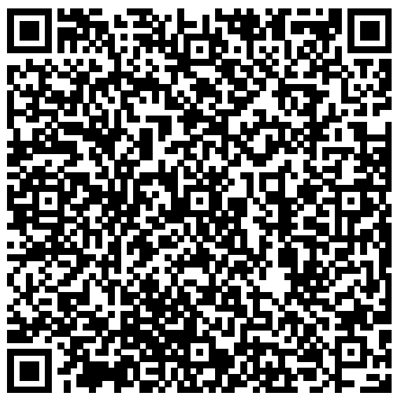
SIGN UP FOR THE ARTSCI ROUNDUP NEWSLETTER
For those near and far, this is your university to explore. Every month, the ArtSci Roundup features in-person and online public events, performances, exhibitions, podcasts, and more. Sign up to receive a monthly email with the latest events and happenings!
artsci.washington.edu/signup

Slide 11


WANT TO CONNECT?
Send us an email at departmentemail@uw.edu.
Follow us on Social Media
[insert handle]
[insert handle]

Slide 12
THANK YOU FOR JOINING US. WE HOPE TO SEE YOU ON CAMPUS AGAIN SOON!

